Slide 1
Week 5 Report
Qi Luo, Sidharth Suravarapu
OSHKOSH PROJECT: Assessment of Autonomous Driving Software Performance on Edge Devices

Slide 2
Primary Objectives
1
Implement Autoware on Ambarella edge device
2
Evaluate the capability of the Ambarella devices
3
Compare the performance of Ambarella device to the NVIDIA ORIN

Slide 3
Completed Tasks
Installed Autoware on Ambarella device (no graphic acceleration)
Installed Ambarella SDK on work laptops (Docker container running Ubuntu 20.04 required)
Used Arm Toolchain to generate SDK documentation
Notes:
Can we run Autoware on Ambrella native system directly?
How do the stack compare to Nvidia Jetson.

Slide 4
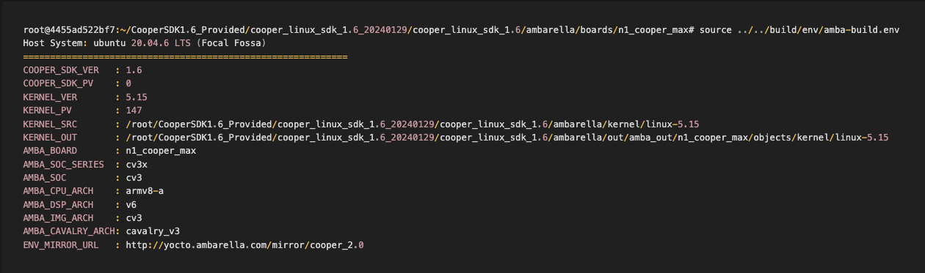
N1 Cooper Max SDK Info

Slide 5
Ongoing Tasks
Running Autoware headless to speed it up
Review the newly generated documentations
New Demos Available:
Access Control Camera (point cloud / biometrics)
Multi-View Video Conference (segments video input into one output per person)
How to log (CPU, NVP, GVP usage)
Find model files (onnx, etc.) for object detection that Autoware uses
Implement and demonstrate performance of converted model with CVFlow

Slide 6
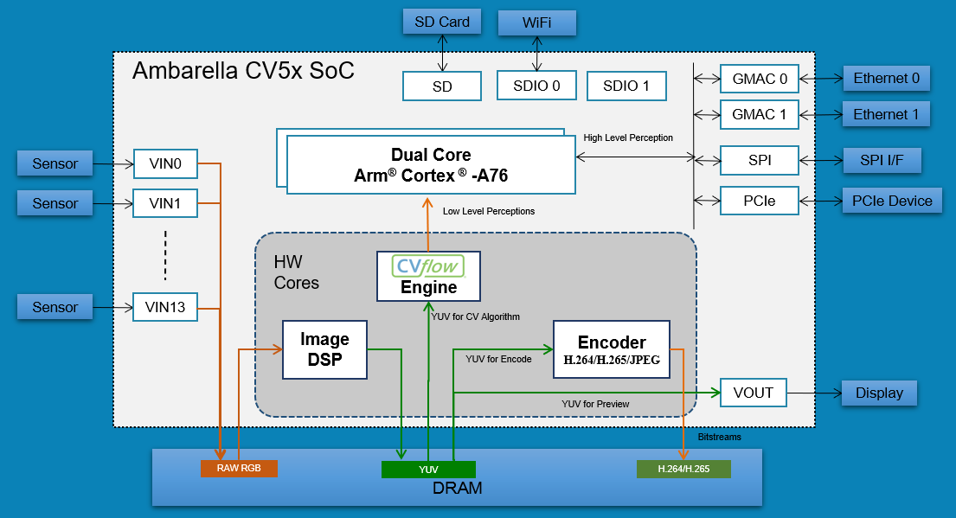
Hardware Block Diagram
Ambarella CV3x SOC
Dual Core Arm Cortex A78AE
Notes:
we’re aware this is a stretch goal

Slide 7
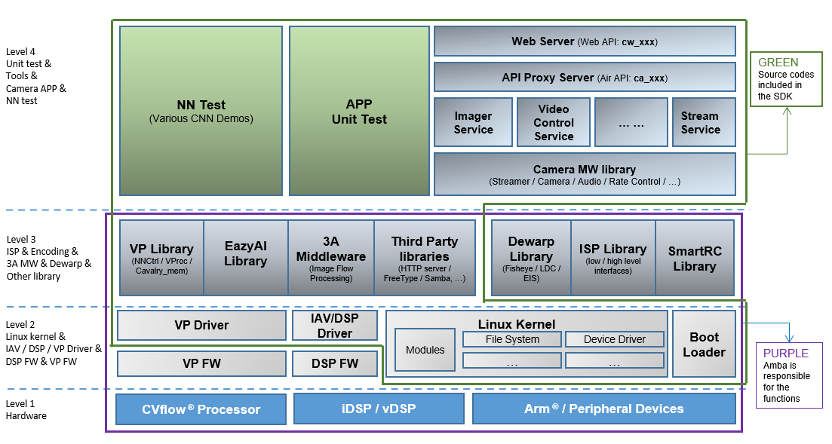
Software Framework

Slide 8
Questions for Ambarella
We are trying to benchmark the performance and capability of Autoware on ambarella device against an Nvidia device.
Can Rviz graphical rendering be hardware accelerated on Ambarella devices, like Nvidia does? Or does there exist alternative rendering software for Ambarella?
What logging software is used for performance benchmarking in the Beetle Demo? (CPU, NVP, GVP usage)
Can we run a docker container that has Nvidia dependencies on the ambarella device? Does the Ambarella hardware meet the necessary requirements to support these dependencies?
Is there a way to directly emulate Nvidia software on the ambarella device? Are there any known issues or limitations when running Nvidia software on the Ambarella device?
What steps are required to ensure compatibility between Nvidia software and the Ambarella device?
Does the ambarella device have a power consumption monitor built in?

